Slide 1
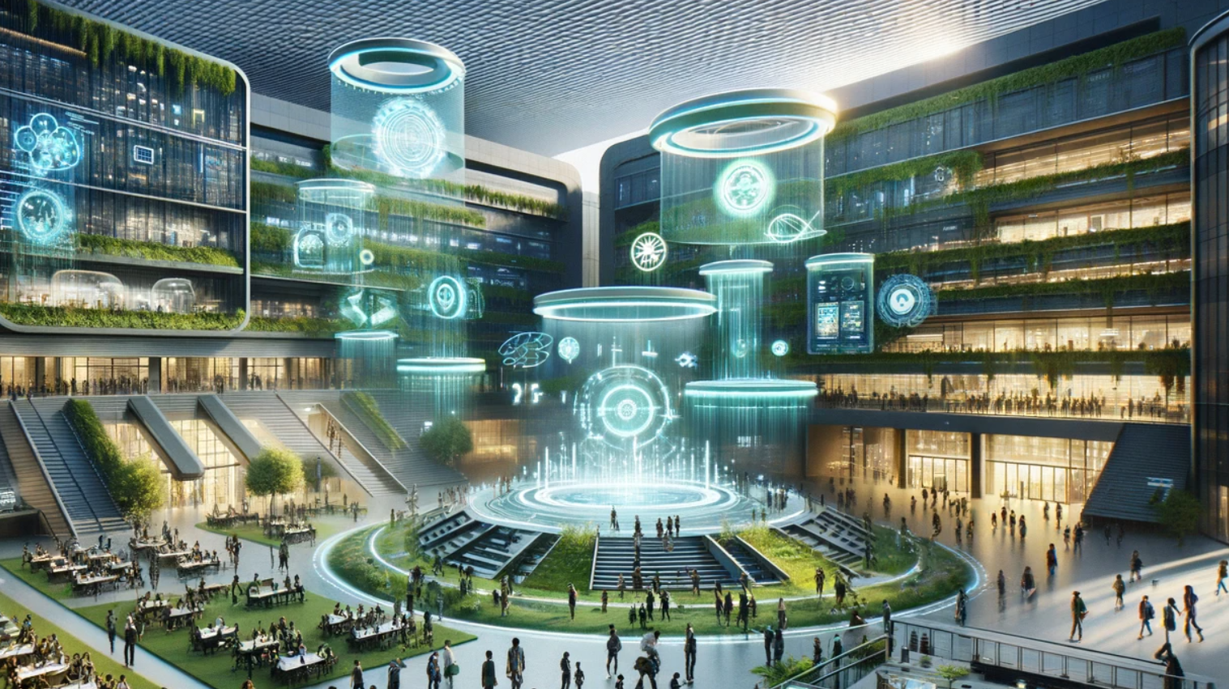
Building an AI-Driven Ecosystem for Universities, Faculty & Students
By Dr. Jasmin (Bey) Cowin
https://drcowinj-locationindependentteach.com/

Slide 2
Placeholder for Wordcloud activity Irina Can you create this activity – I can’t figurte out which tech tool will work in Russia
Prompt: Imagine it's 2060 and you're a student/faculty member at a university transformed by technology.
Describe your learning experience in just a few words. (up to 6 words)
What excites you?
What challenges do you see?

Slide 3
Futuristic Scenario
As Lina enters the campus, her AI assistant, EduBuddy, greets her and updates her on the progress of her research project. The AI has analyzed thousands of research papers overnight and has generated new insights for Lina to explore. In her personalized learning pod, the walls come alive with interactive visualizations tailored to her learning style and pace...

Slide 4
Today’s Reality

Slide 5
What is What?

Slide 6
This Photo by Unknown Author is licensed under CC BY-SA-NC

Slide 7
Generative AI in Higher Education: Language Learning & Teaching – A Catalyst for Change?

Slide 8
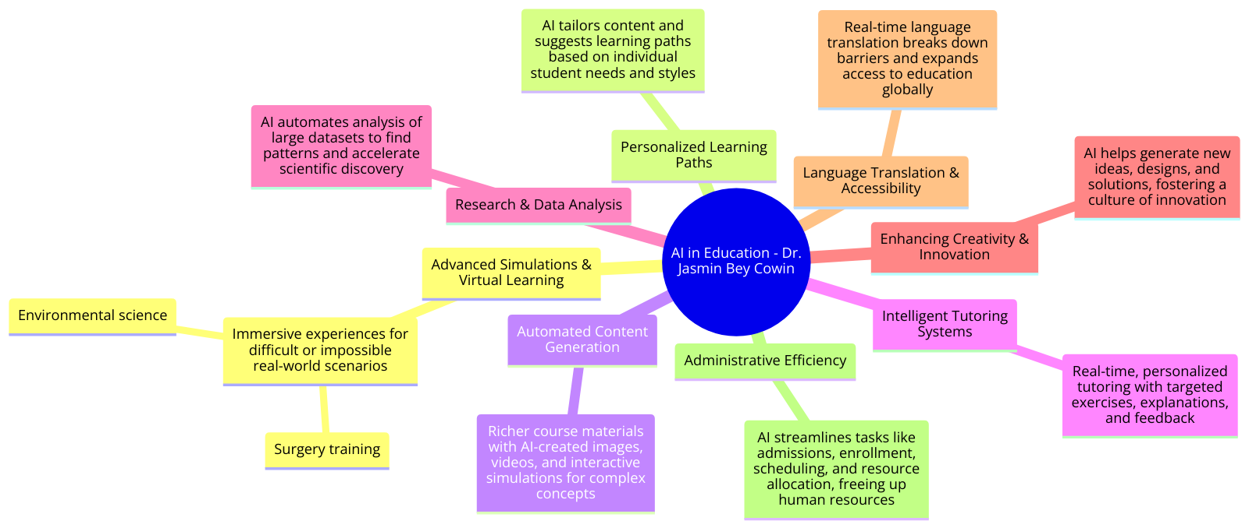
Generative AI in Higher Education: Language Learning & Teaching

Slide 9
At University and Beyond: The Role of Educators and Teachers
This Photo by Unknown Author is licensed under CC BY-SA-NC

Slide 10
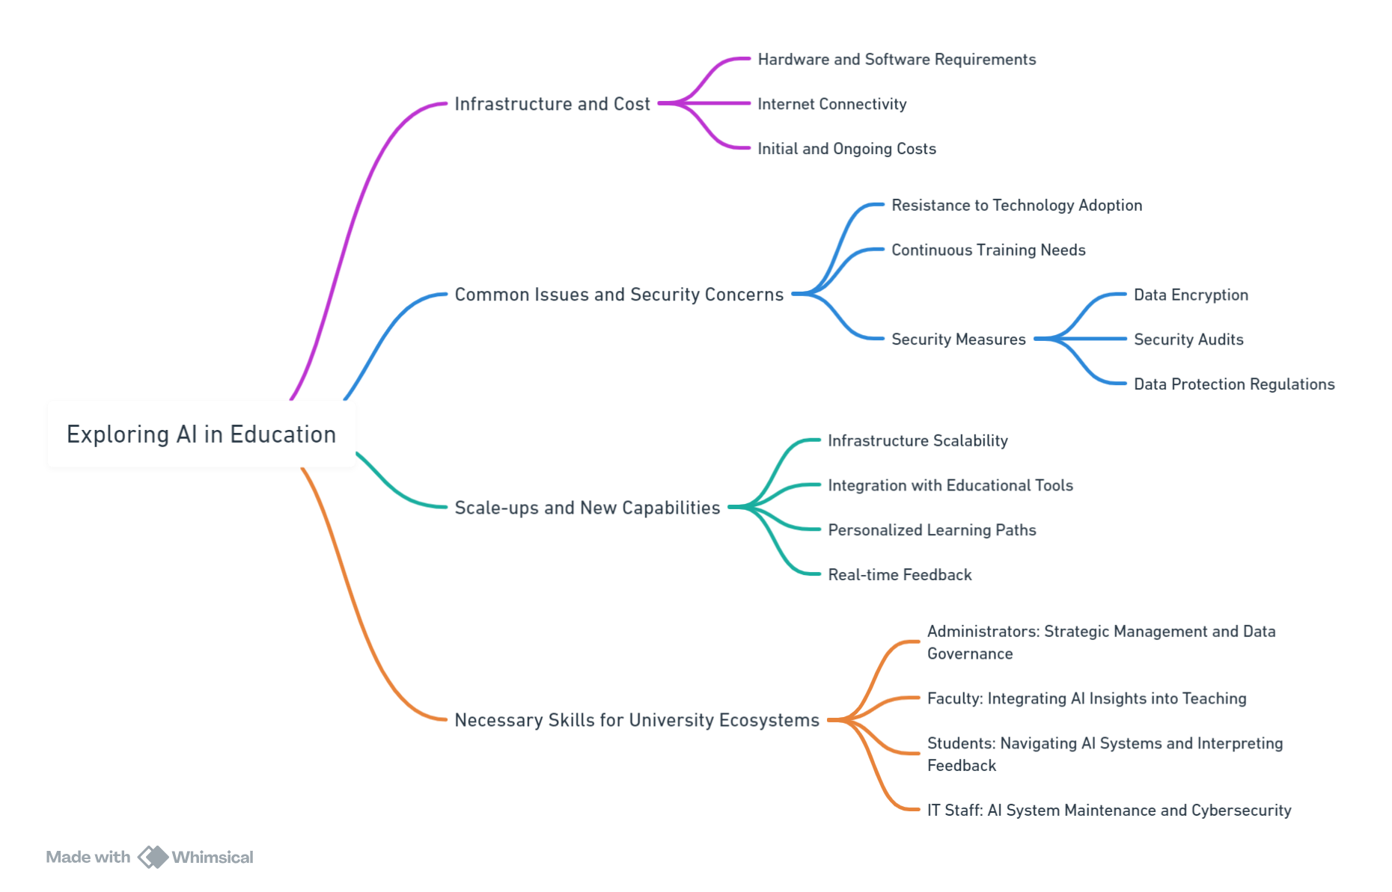

Slide 11
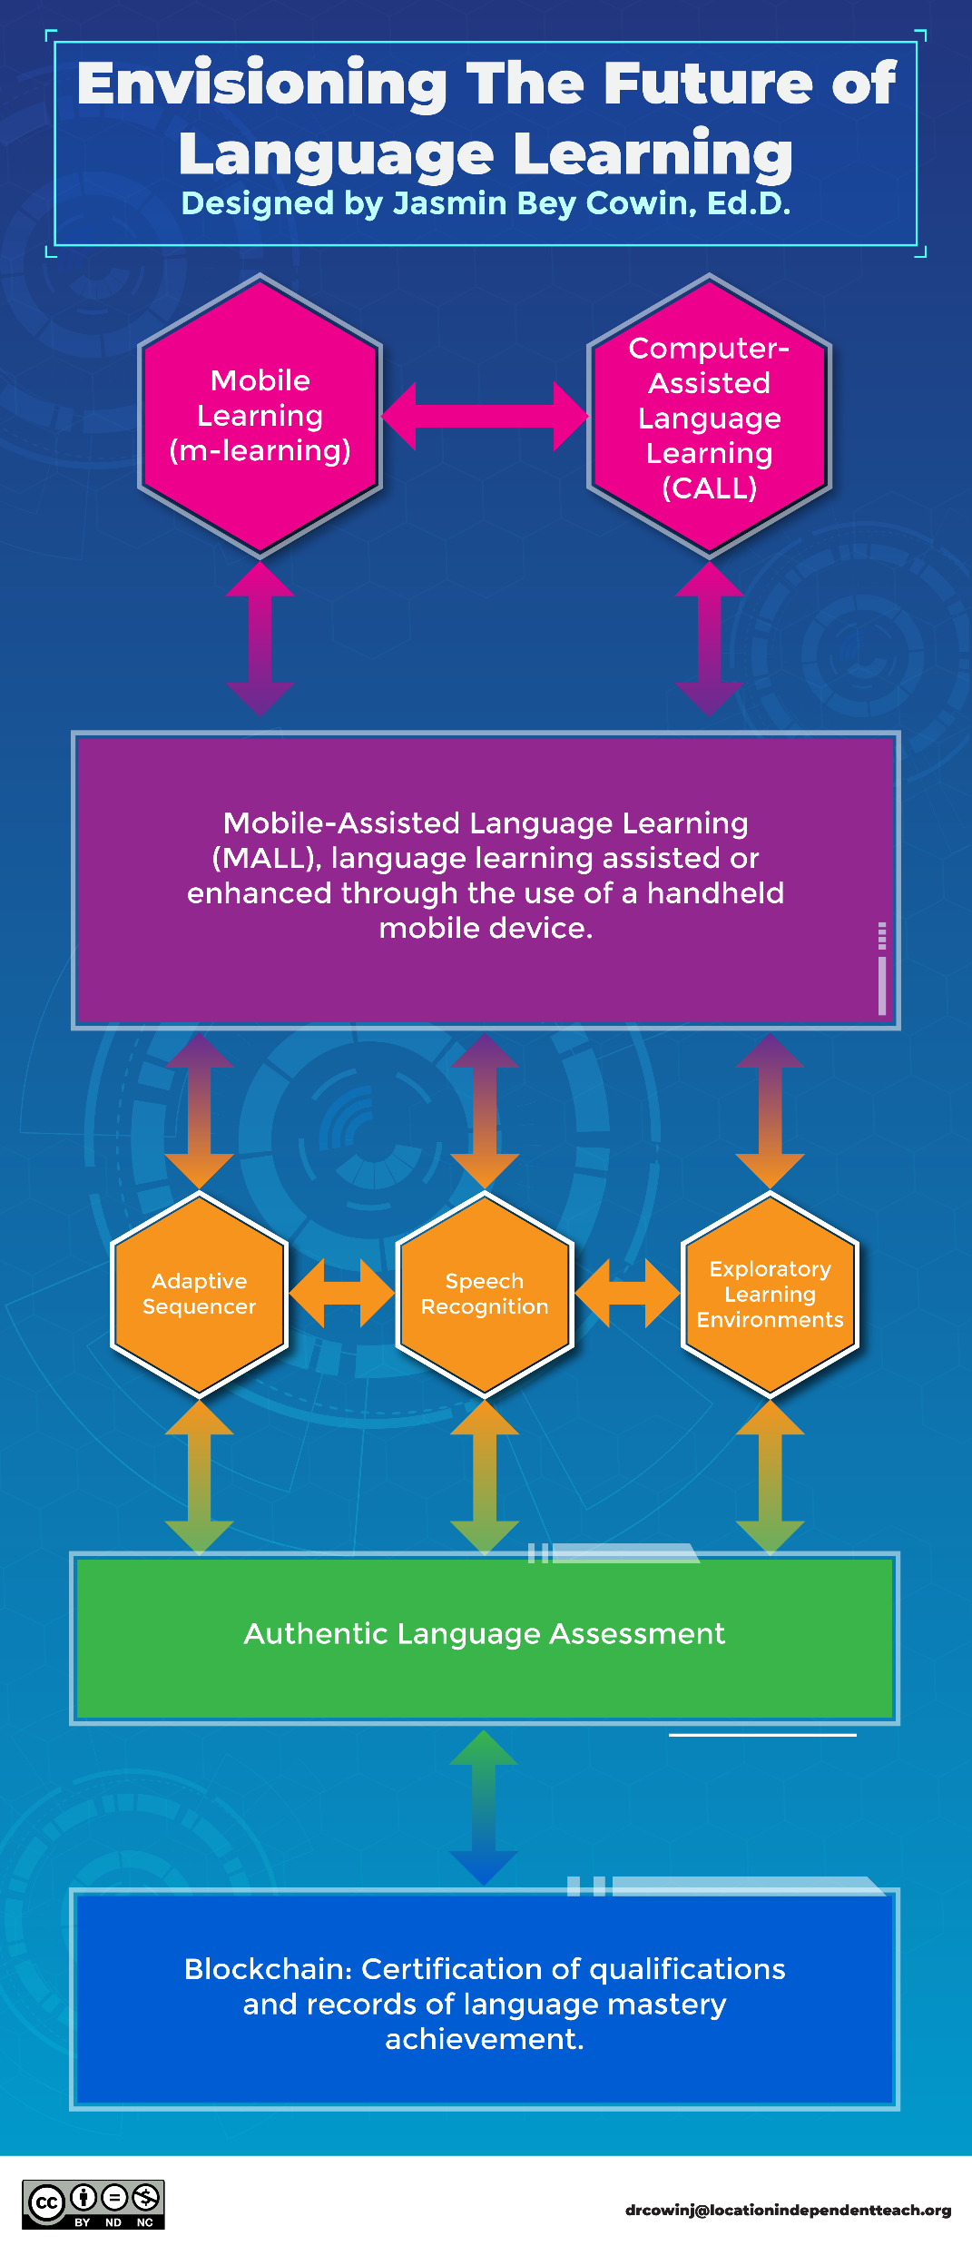

Slide 12
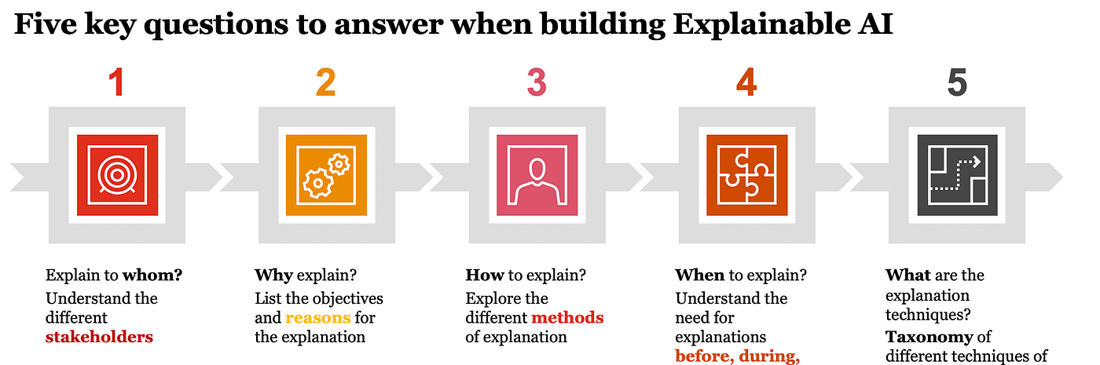
Explainability
Incorporating explainability into AI education and systems design is critical for ensuring that learners and users can understand how AI models make decisions. This understanding is vital for trust, usability, and further development in AI.
This Photo by Unknown Author is licensed under CC BY-SA-NC

Slide 13
Placeholder for Survey Activity Irina would it be possible for you to create this survey so we know it will work?
Language Learning & Technology Survey
Thank you for participating in this brief survey! We're interested in learning about how educators and students use technology for language learning.
Please select the answer that best reflects your experience.
1. Research:
How often do you use technology to find information and resources for language learning (e.g., online dictionaries, grammar websites, language learning apps)?
Never
Rarely
Occasionally
Frequently
Always
2. Teaching/Learning:
Do you use technology in your language learning activities (e.g., online exercises, interactive games, collaborative platforms)?
I rarely use technology.
I use technology occasionally.
I frequently use technology.
I always use technology.
3. Writing & Producing:
Do you use technology tools (e.g., grammar checkers, translation services, collaborative writing platforms) to help you write and produce content in your target language?
Never
Rarely
Occasionally
Frequently
Always
Briefly list a technology tool you find helpful for writing and producing content in your target language.

Slide 14
AI advancements & Versatility
Games have long been a proving ground for new AI advancements — from Deep Blue’s victory over chess grandmaster Garry Kasparov, to AlphaGo’s mastery of Go, to Pluribus out-bluffing the best humans in poker.

Slide 15
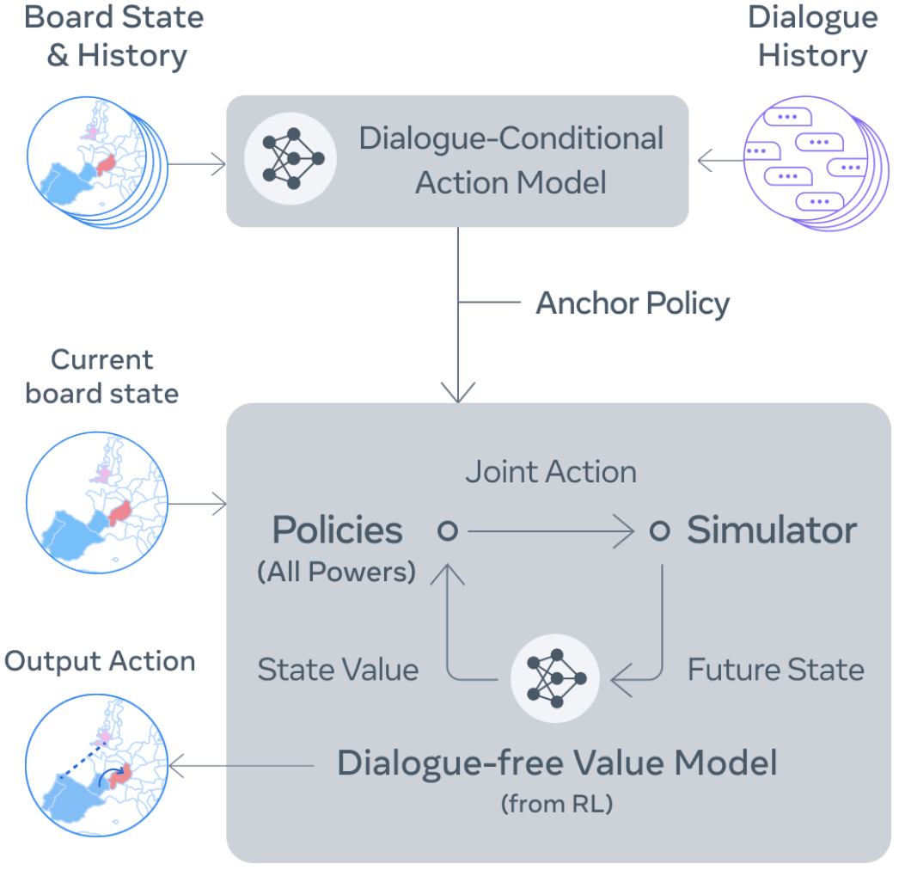
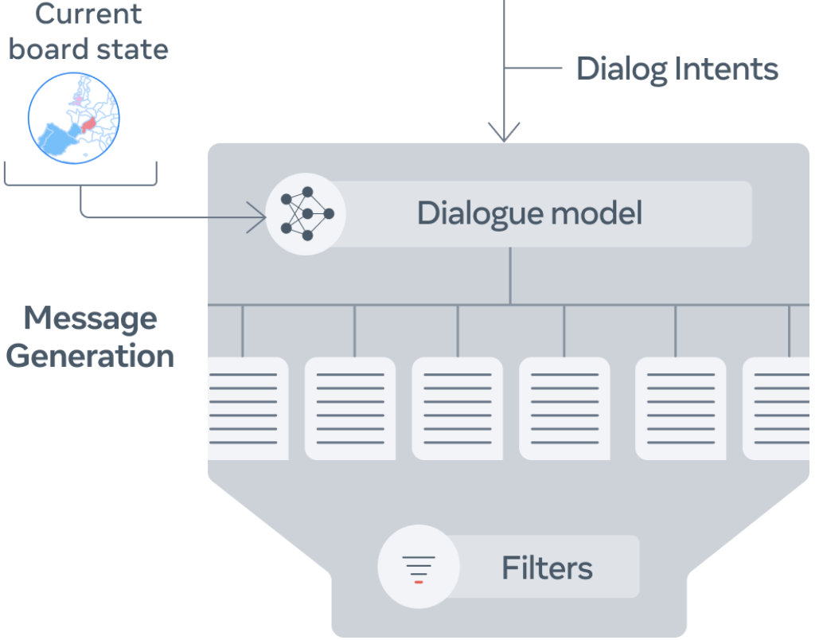
CICERO masters natural language to beat humans at Diplomacy https://arstechnica.com/information-technology/2022/11/meta-researchers-create-ai-that-masters-diplomacy-tricking-human-players/
CICERO uses dialogue history between players as well as the board state and its history to begin predicting what everyone will do. It then iteratively refines these predictions using planning, then decides according to a policy which action it intends to take. CICERO then generates and filters candidate messages to communicate with players.
The controllable dialogue model it uses is based on a 2.7B-params BART-like model fine-tuned on >40K online games of Diplomacy. CICERO uses a new iterative planning algorithm based on piKL which improves the predictions of other players’ moves after dialoguing with them.
This Photo by Unknown Author is licensed under CC BY-SA-NC
Notes:
Meta trained an AI agent to play a popular multiplayer strategy game called Diplomacy, which involves planning and negotiating in natural language with other players over multiple rounds. CICERO achieved double the average score of human players online and ranked in the top 10% players who played more than one game.
Fast parallel progress in strategic planning and language modeling allows for potentially great advancements at the intersection, with applications in human-AI cooperation. Meta tackles the game of Diplomacy as a benchmark for such progress.

Slide 16
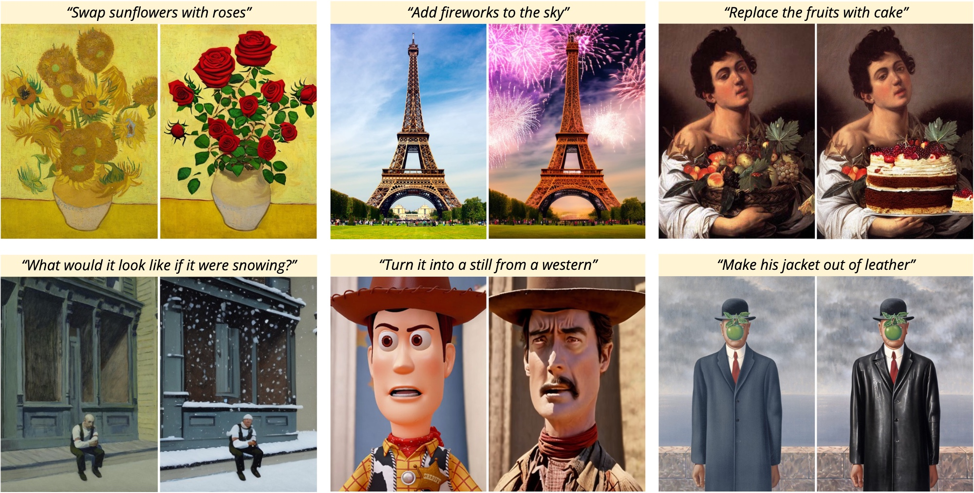
Instruction based editing assistants for text-image generation
InstructPix2Pix, leverages pre-trained GPT3 and StableDiffusion to generate a large dataset of {input image, text instruction, generated image} triplets to train a supervised conditional diffusion model. Editing then happens in a feed-forward way without any per image fine tuning/inversion, enabling modifications in seconds.
Masked inpainting methods such as Imagen Editor require providing the model with an overlay or “mask” to indicate the region to modify, alongside text instructions.
Building on these approaches, startups such as Genmo AI’s “Chat” provide a co-pilot style interface for image generation with text-guided semantic editing.
This Photo by Unknown Author is licensed under CC BY-SA-NC

Slide 17
Metaverses such as Agora World

Slide 18
Intelligent Tutoring Systems (ITS)
Domain Model
Student Model
Tutoring Model
User Interface

Slide 19
Biomimicry and Neuromimicry
Biomimicry
Definition: Biomimicry is the practice of studying and taking inspiration from nature’s models, systems, processes, and elements to solve human problems.
Neuromimicry
Definition: Neuromimicry is a subset of biomimicry that specifically focuses on emulating the structures, functions, or processes of the nervous system, including the brain, to develop artificial systems. This approach seeks to mimic the brain’s ability to learn, adapt, and process information in an effort to improve computational models, create more sophisticated artificial intelligence, and develop systems that can mimic human cognitive processes.
This Photo by Unknown Author is licensed under CC BY-SA-NC

Slide 20
Biomimicry in AI Development
Critical Perspective: The application of biomimicry in developing AI systems for language learning could lead to innovative teaching tools but also raises questions about the scalability and ethical implications of such technologies. Mimicking natural systems does not always guarantee sustainability or ethical practices, especially when the biological inspirations are not fully understood.
Example: An administration might invest in developing an AI-based language learning platform inspired by the social learning behaviors of certain species. While this could foster collaborative and immersive learning environments, it might also inadvertently encourage conformity, limiting creative and critical thinking in students if not carefully designed.

Slide 21
What might an AI-Driven Ecosystem for Universities, Faculty & Students look like?

Slide 22
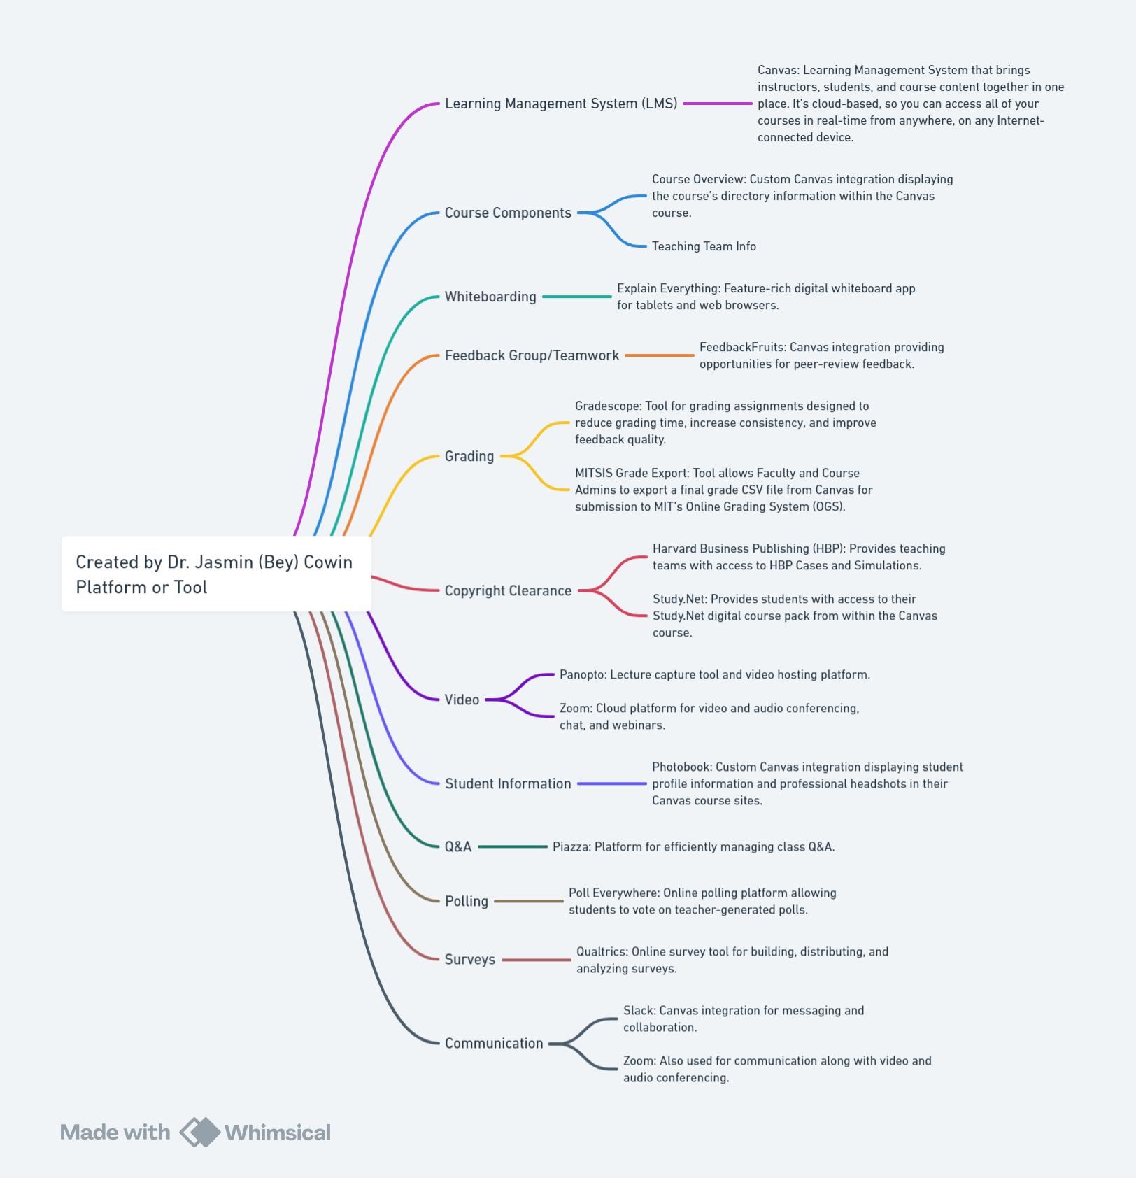

Slide 23
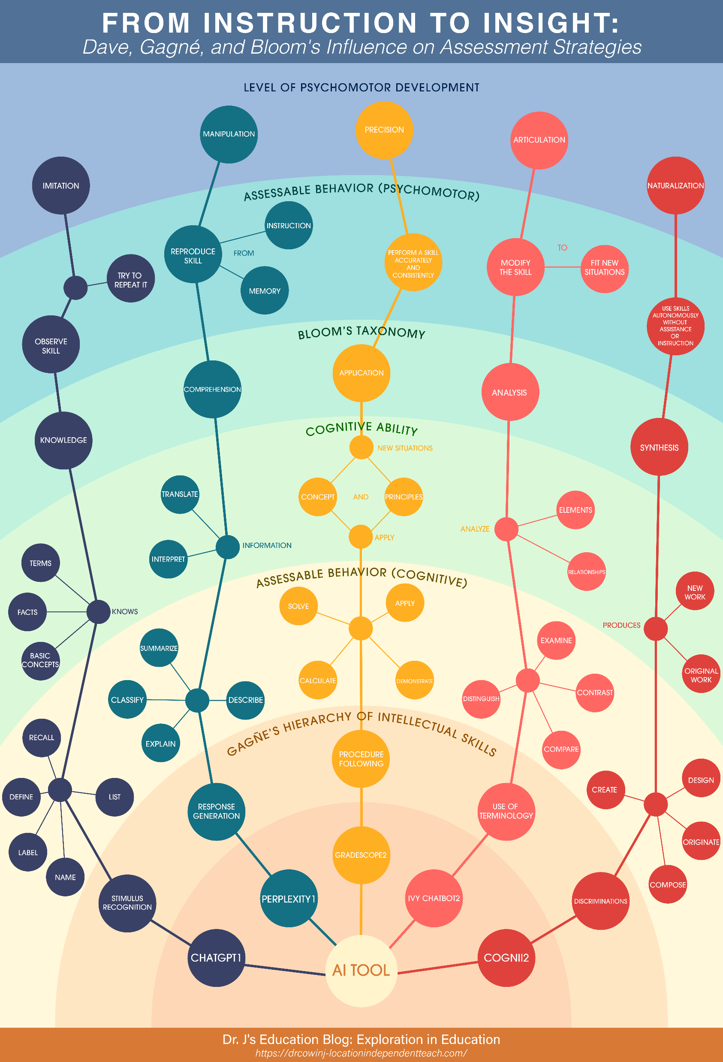

Slide 24
Abreviated taxonomy of catastrophic AI risk
There is no consensus about the actual risks that AI systems pose on a reasonable time horizon. The figure below is taken from An Overview of Catastrophic AI Risks, by Dan Hendrycks (Center for AI Safety).
This Photo by Unknown Author is licensed under CC BY-SA-NC

Slide 25
Questions?
This Photo by Unknown Author is licensed under CC BY-SA-NC

Slide 26
End of Plenary Survey Placeholder Irina could you do this?
Thank you for attending today's session! We appreciate your time and participation.
Please take a moment to answer these quick questions to help us improve future sessions.
1. How interesting did you find today's plenary?
Not interesting at all
Somewhat interesting
Interesting
Very interesting
Extremely interesting
2. What topic covered today would you like to know more about?

Slide 27
Building an AI-Driven Ecosystem for Universities, Faculty & Students
By Dr. Jasmin (Bey) Cowin

